Slide 1
Microsoft Teams Developer
Authentication

Slide 2

Authentication in Bots
AAD Bot Authentication
Azure Bot Service and OAuth Card
Demo

Slide 3
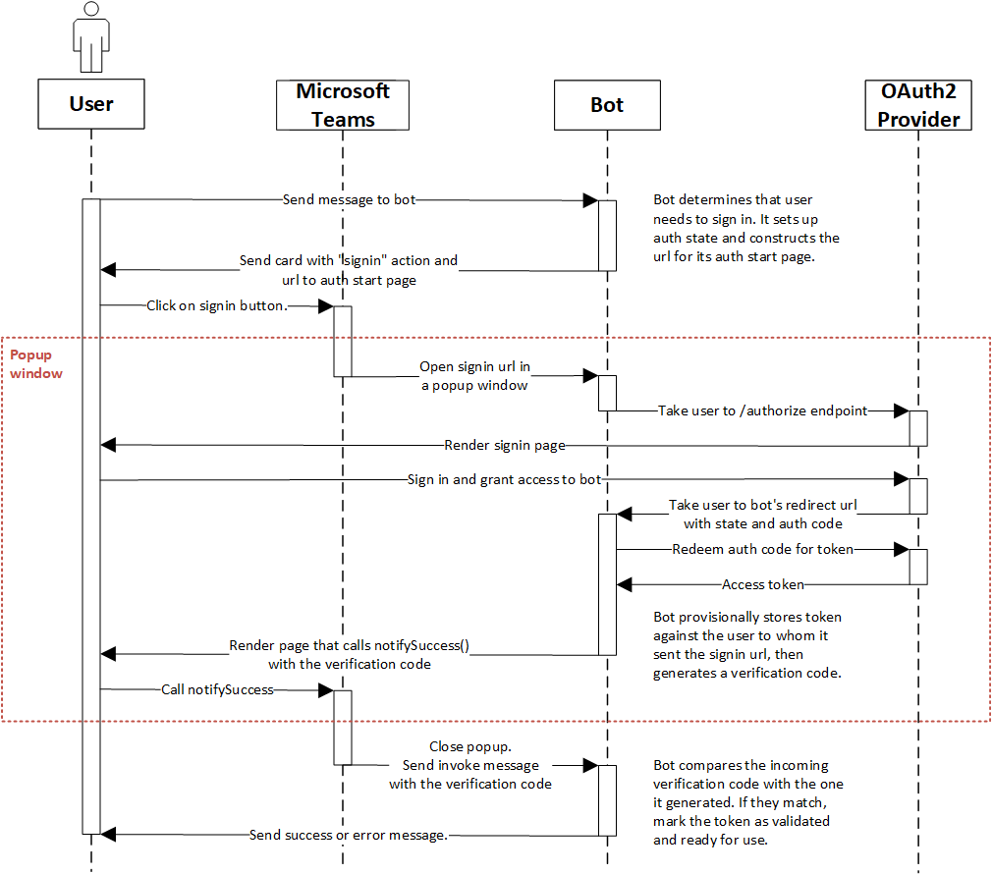
Authentication Flow for bots
Notes:
The canonical authentication graphic. Highlight the Popup Window section, which is opened/closed by Teams, not the developer

Slide 4
Authentication using the Azure Bot Service
With Azure Bot Service’s OAuthCard, it is easier for your Teams bot to sign in your users and access external data providers.
Support for the Oauth Card
The card will not work with guest access
It will not work with Microsoft Teams free
It can only be used for bot authentication
It only works for bots registered in the Azure Bot Service
The Bot Framework SDK for Node.js does not currently support OAuthCard
Main benefits for Teams developers
Provides an out-of-box web-based authentication flow
Complete the full sign in experience right within Teams.
Includes token management
Is supported by complete SDKs
Out-of-box support for many popular OAuth providers

Slide 5
Demo Add authentication to a bot

Slide 6

Summary
AAD Bot Authentication
Azure Bot Service and OAuth Card

Slide 7
Thank you

